Slide 1
CSD3009 -
DATA STRUCTURES AND ANALYSIS OF ALGORITHMS
DR.S.DEVARAJU

Slide 2
Module 5
Graph Traversal: Breadth First Search (BFS), Depth First Search (DFS) - Minimum Spanning Tree: Prim's, Kruskal's- Single Source Shortest Path: Dijkstra’s Algorithm.
https://www.javatpoint.com/data-structure-tutorial

Slide 3
Graph Traversal Techniques
The previous connectivity problem, as well as many other graph problems, can be solved using graph traversal techniques
There are two standard graph traversal techniques:
  Depth-First Search (DFS)
  Breadth-First Search (BFS)

Slide 4
Graph Traversal (Contd.)
In both DFS and BFS, the nodes of the undirected graph are visited in a systematic manner so that every node is visited exactly one.
Both BFS and DFS give rise to a tree:
  When a node x is visited, it is labeled as visited, and it is added to the tree
  If the traversal got to node x from node y, y is viewed as the parent of x, and x a child of y

Slide 5
Depth-First Search
DFS follows the following rules:
  Select an unvisited node x, visit it, and treat as the current node
  Find an unvisited neighbor of the current node, visit it, and make it the new current node;
  If the current node has no unvisited neighbors, backtrack to the its parent, and make that parent the new current node;
  Repeat steps 3 and 4 until no more nodes can be visited.
  If there are still unvisited nodes, repeat from step 1.

Slide 6
Illustration of DFS
0
1
0
2
1
4
4
9
10
5
7
2
11
8
5
9
6
7
11
6
Graph G
8
10
DFS Tree

Slide 7
Implementation of DFS
Observations:
  the last node visited is the first node from which to proceed.
  Also, the backtracking proceeds on the basis of "last visited, first to backtrack too".
  This suggests that a stack is the proper data structure to remember the current node and how to backtrack.

Slide 8
Illustrate DFS with a Stack
We will redo the DFS on the previous graph, but this time with stacks
In Class

Slide 9
DFS (Pseudo Code)
DFS(input: Graph G) {
Stack S; Integer x, t;
while (G has an unvisited node x){
visit(x); push(x,S);
while (S is not empty){
t := peek(S);
if (t has an unvisited neighbor y){ visit(y); push(y,S); }
else
pop(S);
}
}
}

Slide 10
C++ Code for DFS
int * dfs(Graph G){ // returns a parent array representing the DFS tree
int n=G.getNumberOfNodes();
int * parent = new int[n];
Stack S(n); bool visited[n];
for ( int i=0; i<n; i++) visited[i]=false;
int x=0; // begin DFS from node 0
int numOfConnectedComponents=0;
while (x<n){ // begin a new DFS from x
numOfConnectedComponents++;
visited[x]=true; S.push(x); parent[x] = -1; // x is root
while(!S.isEmpty()) // traverse the current piece
// insert here the yellow box from the next slide
x= getNextUnvisited(visited,n,x);
}
cout<<“Graph has “<< numOfConnectedComponents<<
“ connected components\n”;
return p;
}

Slide 11
{
  int t=S.peek( );
  int y=getNextUnvisitedNeighbor(
  t,G,visited,n);
  if (y<n){
  visited[y]=true;
  S.push(y);
  parent[y]=t;
  }
  else S.pop( );
}
// Put this before dfs(…)
// returns the leftmost unvisited
// neighbor of node t. If none
// remains, returns n.
int getNextUnvisitedNeighbor(int t,
graph G, bool visited[],int n){
for (int j=0;j<n;j++)
if (G.isEdge(t,j) && !visited[j])
return j;
// if no unvisited neighbors left:
return n;
}
//Put this before dfs(…). This returns the next unvisited node, or n otherwise
int getNextUnvisited(bool visited[],int n, int lastVisited){
int j=lastVisited+1;
while (visited[j] && j<n) j++;
return j;
}

Slide 12
Breadth-First Search
BFS follows the following rules:
  Select an unvisited node x, visit it, have it be the root in a BFS tree being formed. Its level is called the current level.
  From each node z in the current level, in the order in which the level nodes were visited, visit all the unvisited neighbors of z. The newly visited nodes from this level form a new level that becomes the next current level.
  Repeat step 2 until no more nodes can be visited.
  If there are still unvisited nodes, repeat from Step 1.

Slide 13
Illustration of BFS
0
1
0
2
4
2
1
4
9
5
9
10
10
5
7
11
8
6
7
8
11
6
BFS Tree
Graph G

Slide 14
Implementation of DFS
Observations:
  the first node visited in each level is the first node from which to proceed to visit new nodes.
This suggests that a queue is the proper data structure to remember the order of the steps.

Slide 15
Illustrate BFS with a Queue
We will redo the BFS on the previous graph, but this time with queues
In Class

Slide 16
BFS (Pseudo Code)
BFS(input: graph G) {
Queue Q; Integer x, z, y;
while (G has an unvisited node x) {
visit(x); Enqueue(x,Q);
while (Q is not empty){
z := Dequeue(Q);
for all (unvisited neighbor y of z){ visit(y); Enqueue(y,Q);
}
}
}
}

Slide 17
Things for you to Do
Give a C++ implementation of BFS, using the pseudo code as your guide
Use BFS as a way to determine of the input graph G is connected, and if not, to output the number of connected components
Modify BFS so that the level of each node in the BFS tree is computed.
Give another class for graph, this time using a linked lists representation.

Slide 18
Spanning Trees
When graph G is connected, a depth first or
breadth first search starting at any vertex will
visit all vertices in G
A spanning tree is any tree that consists solely
of edges in G and that includes all the vertices
E(G): T (tree edges) + N (nontree edges)
where T: set of edges used during search
N: set of remaining edges

Slide 19
Examples of Spanning Tree
0
0
0
0
1
2
1
2
1
2
1
2
3
3
3
3
G1
Possible spanning trees

Slide 20
Spanning Trees
Either dfs or bfs can be used to create a
spanning tree
  When dfs is used, the resulting spanning tree is
  known as a depth first spanning tree
  When bfs is used, the resulting spanning tree is
  known as a breadth first spanning tree
While adding a nontree edge into any spanning
tree, this will create a cycle

Slide 21
DFS VS BFS Spanning Tree
0
0
0
1
2
1
2
1
2
3
4
5
6
3
4
5
6
3
4
5
6
7
7
nontree edge
cycle
7
DFS Spanning
BFS Spanning

Slide 22
A spanning tree is a minimal subgraph, G’, of G
such that V(G’)=V(G) and G’ is connected.
Any connected graph with n vertices must have
at least n-1 edges.
A biconnected graph is a connected graph that has
no articulation points.
0
1
2
biconnected graph
3
4
5
6
7

Slide 23
0
8 9
2
1
7
3
5
connected graph
4
6
two connected components
one connected graph
8 9
0
8 9
0
2
7
2
1
7
1
3
5
3
5
4
6
4
6

Slide 24
biconnected component: a maximal connected subgraph H
(no subgraph that is both biconnected and properly contains H)
0
8
9
0
8 9
1
7
7
2
1
7
2
1
7
3
5
3
3
5
5
4
6
4
6
biconnected components

Slide 25
Find biconnected component of a connected undirected graph
by depth first spanning tree
nontree
edge
(back edge)
0
3
4 0
9 8 9 8
1 5
nontree
edge
(back edge)
4
5
1
7 7
3
0 5
3 5
2
6
7
6
2 2
2
4
3
1
7
dfn
depth
first
number
8 9
4 6
1 6
9
8
0
Why is cross edge impossible?
(a) depth first spanning tree (b)
If u is an ancestor of v then dfn(u) < dfn(v).

Slide 26
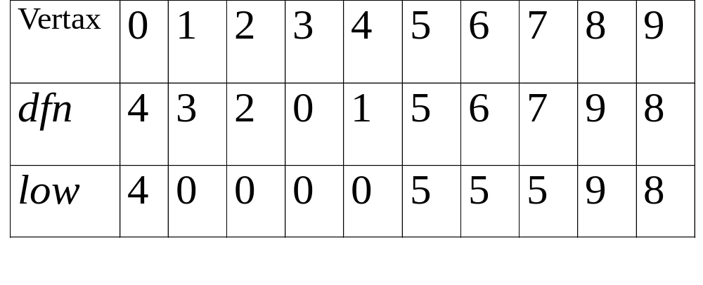
dfn and low values for dfs spanning tree with root =3

Slide 27
0
3
*The root of a depth first spanning
tree is an articulation point iff
it has at least two children.
1 5
4
5
2
6
7
6
2
4
*Any other vertex u is an articulation point iff it has at least one child w such that we cannot reach an ancestor of u using a path that consists of (1) only w (2) descendants of w (3) single back edge.
3
1
7
8 9
0
9
8
low(u)=min{dfn(u),
min{low(w)|w is a child of u},
min{dfn(w)|(u,w) is a back edge}
u: articulation point
low(child) ≥ dfn(u)

Slide 28
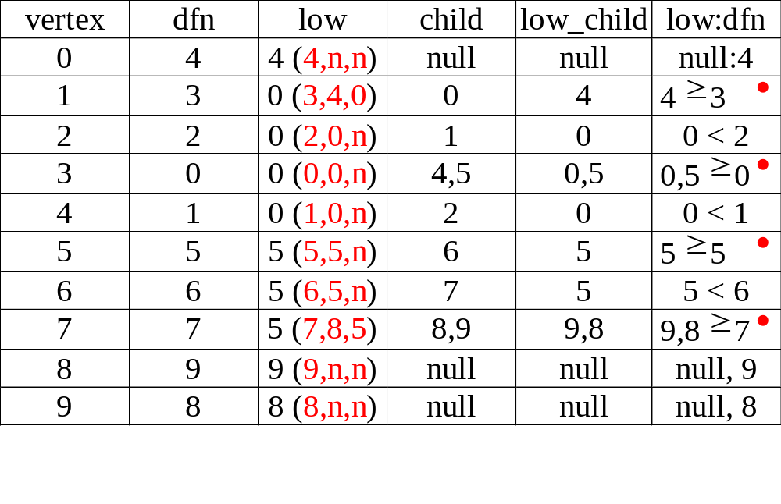
3
1 5
4
5
2
6
7
6
2
4
3
1
7
8 9
0
9
8

Slide 29
Initializaiton of dfn and low
void init(void)
{
int i;
for (i = 0; i < n; i++) {
visited[i] = FALSE;
dfn[i] = low[i] = -1;
}
num = 0;
}

Slide 30
Determining dfn and low
void dfnlow(int u, int v)
{
/* compute dfn and low while performing a dfs search
beginning at vertex u, v is the parent of u (if any) */
node_pointer ptr;
int w;
dfn[u] = low[u] = num++;
for (ptr = graph[u]; ptr; ptr = ptr ->link) {
w = ptr ->vertex;
if (dfn[w] < 0) { /*w is an unvisited vertex */
dfnlow(w, u);
low[u] = MIN2(low[u], low[w]);
}
else if (w != v)
low[u] =MIN2(low[u], dfn[w] );
}
}
Initial call: dfn(x,-1)
low[u]=min{dfn(u), …}
v
u
w
v
u
low[u]=min{…, min{low(w)|w is a child of u}, …}
X
O
dfn[w]0 is not the first time, indicating back edge
low[u]=min{…,…,min{dfn(w)|(u,w) is a back edge}

Slide 31
Biconnected components of a graph
void bicon(int u, int v)
{
/* compute dfn and low, and output the edges of G by their
biconnected components , v is the parent ( if any) of the u
(if any) in the resulting spanning tree. It is assumed that all
entries of dfn[ ] have been initialized to -1, num has been
initialized to 0, and the stack has been set to empty */
node_pointer ptr;
int w, x, y;
dfn[u] = low[u] = num ++;
for (ptr = graph[u]; ptr; ptr = ptr->link) {
w = ptr ->vertex;
if ( v != w && dfn[w] < dfn[u] )
add(&top, u, w); /* add edge to stack */
low[u]=min{dfn(u), …}
(1) dfn[w]=-1 first
(2) dfn[w]!=-1 is not the first time, by back edge

Slide 32
if(dfn[w] < 0) {/* w has not been visited */ bicon(w, u); low[u] = MIN2(low[u], low[w]); if (low[w] >= dfn[u] ){ articulation point printf(“New biconnected component: “); do { /* delete edge from stack */ delete(&top, &x, &y); printf(“ <%d, %d>” , x, y);
} while (!(( x = = u) && (y = = w))); printf(“\n”);
}
} else if (w != v) low[u] = MIN2(low[u], dfn[w]);
}
}
low[u]=min{…, min{low(w)|w is a child of u}, …}
low[u]=min{…, …, min{dfn(w)|(u,w) is a back edge}}

Slide 33
Minimum Spanning Tree (MST)

Slide 34
Minimum Cost Spanning Tree
The cost of a spanning tree of a weighted undirected graph is the sum of the costs of the edges in the spanning tree
A minimum cost spanning tree is a spanning
tree of least cost
Two different algorithms can be used
  Kruskal
  Prim
Select n-1 edges from a weighted graph
of n vertices with minimum cost.

Slide 35
Greedy Strategy
An optimal solution is constructed in stages
At each stage, the best decision is made at this
time
Since this decision cannot be changed later,
we make sure that the decision will result in a feasible solution
Typically, the selection of an item at each
stage is based on a least cost or a highest profit criterion

Slide 36

MST

Slide 37
Kruskal’s Idea
Build a minimum cost spanning tree T by
adding edges to T one at a time
Select the edges for inclusion in T in
nondecreasing order of the cost
An edge is added to T if it does not form a
cycle
Since G is connected and has n > 0 vertices,
exactly n-1 edges will be selected
https://www.youtube.com/watch?v=xn11tv6B4zw

Slide 38


Examples for Kruskal’s Algorithm
weight

Slide 39



Examples for Kruskal’s Algorithm

Slide 40
Examples for Kruskal’s Algorithm
10
0 5
2 3
1 6
1 2
3 6
3 4
4 6
4 5
0 1
12
14
0
0
0
28
16
1
1
10
1
10
14
16
18
6
2
5
6
2
5
6
2
5
24
22
25
18
12
4
4
4
22
3
3
3
24
25
28
6/9

Slide 41
10
0 5
2 3
1 6
1 2
3 6
3 4
4 6
4 5
0 1
12
14
0
16
0
0
1
1
10
10
1
10
18
14
14
16
5
6
2
5
6
2
5
6
2
22
4
12
12
12
24
4
4
3
3
3
25
28
+
3 6
cycle

Slide 42
10
12
0 5
2 3
1 6
1 2
3 6
3 4
4 6
4 5
0 1
14
16
0
0
10
1
10
1
18
14
16
14
16
5
6
2
5
6
2
22
25
12
12
24
4
4
22
4 6
22
3
+
3
25
cycle
cost = 10 +25+22+12+16+14
28

Slide 43
Kruskal’s Algorithm
Goal: Take out N-1 edges
T= {};
while (T contains less than n-1 edges
&& E is not empty) {
choose a least cost edge (v,w) from E;
delete (v,w) from E;
if ((v,w) does not create a cycle in T)
add (v,w) to T
else discard (v,w);
}
if (T contains fewer than n-1 edges)
printf(“No spanning tree\n”);
min heap construction time O(e)
choose and delete O(log e)
find find & union O(log e)
{0,5}, {1,2,3,6}, {4} + edge(3,6) X + edge(3,4) --> {0,5},{1,2,3,4,6}
O(e log e)

Slide 44


Prim’s Algorithm
(tree all the time vs. forest)
T={};
TV={0};
while (T contains fewer than n-1 edges)
{
let (u,v) be a least cost edge such
that and
if (there is no such edge ) break;
add v to TV;
add (u,v) to T;
}
if (T contains fewer than n-1 edges)
printf(“No spanning tree\n”);
https://www.youtube.com/watch?v=FVoXffphlCg
Difference: https://www.youtube.com/watch?v=Yu0Ply5_-2o

Slide 45

Examples for Prim’s Algorithm

Slide 46

Examples for Prim’s Algorithm

Slide 47


Examples for Prim’s Algorithm
Lightest edges={(b,d)}

Slide 48


Examples for Prim’s Algorithm

Slide 49


Examples for Prim’s Algorithm
{f,g}}
{f,g}}

Slide 50


Difference betwee s' Kruskals and Prims:
from
Yet in

Slide 51


Difference betwee s' Kruskals and Prims:
Vertice
MST

Slide 52
Examples for Prim’s Algorithm
0
28
10
1
14
16
5
6
2
24
25
0
18
12
0
0
4
10
1
22
3
1
10
1
10
5
6
2
5
6
2
5
6
2
25
25
4
4
4
3
3
22
3

Slide 53
0
28
10
1
14
16
5
6
2
24
25
18
12
4
22
3
0
0
0
10
1
10
1
10
1
16
14
16
5
6
2
5
6
2
5
6
2
25
25
25
4
12
4
12
4
12
22
3
22
3
22
3

Slide 54
Graph and shortest paths from v₀
Single Source All Destinations
Determine the shortest paths from v0 to all the remaining vertices.
45
V₀
50 10
path length
1) v0 v2 10
2) v0 v2 v3 25
3) v0 v2 v3 v1 45
4) v0 v4 45
(b)
V₁
V₄
20 10 15 20 35 30
V₂
15 3
V₃
V₅
(a)

Slide 55
Example for the Shortest Path
Boston
4
1500
San
Francisco
Chicago
Denver
1200
3
250
800
2
1000
1
5
New
York
300
1000
1400
1700
New Orleans
900
0
7
1000
Los Angeles
6
Miami
0 1 2 3 4 5 6 7
0 0
1 300 0
2 1000 800 0
3 1200 0
4 1500 0 250
5 1000 0 900 1400
6 0 1000
7 1700 0
Cost adjacency matrix

Slide 56
(a)
(b)
(c)
4
1500
4
1500
4
250
3
3
5
250
250
5
1000
5
900
6
Pick 5
4 to 3 changed from 1500 to 1250
4 to 6 changed from  to 1150
4
4
(d)
(f)
4
(e)
3
250
250
1000
250
5
5
7
1400
5
7
1400
7
1400
900
6
1000
900
6
Pick 6
4 to 7 changed from  to 1650
4-5-6-7 is longer than 4-5-7

Slide 57
(g)
(h)
4
4
3
1200
3
250
2
1000
250
5
1000
7
1400
5
7
1400
900
900
6
6
Pick 3
4 to 2 changed from  to 2450
(i)
4
4
1200
3
(j)
2
250
250
1000
0
5
5
7
1400
7
1400
900
6
4 to 0 changed from  to 3350
Pick 7

Slide 58
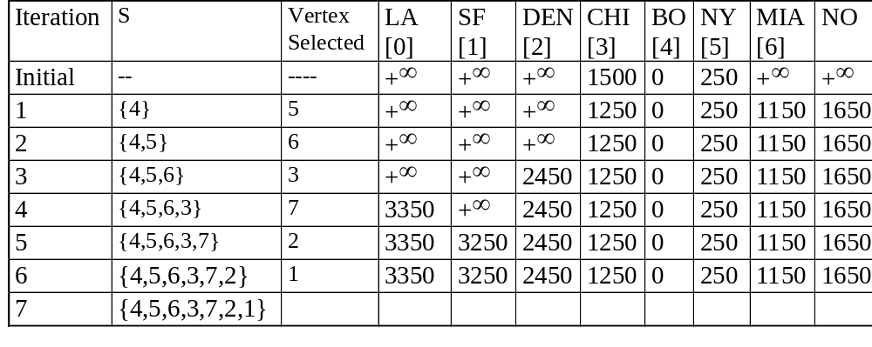
Example for the Shortest Path
(Continued)
(b)
(c)
(d)
(a)
(f)
(e)
(h)
(g)
(j)
(i)

Slide 59
Data Structure for SSAD
#define MAX_VERTICES 6
int cost[][MAX_VERTICES]=
{{ 0, 50, 10, 1000, 45, 1000},
{1000, 0, 15, 1000, 10, 1000},
{ 20, 1000, 0, 15, 1000, 1000},
{1000, 20, 1000, 0, 35, 1000},
{1000, 1000, 30, 1000, 0, 1000},
{1000, 1000, 1000, 3, 1000, 0}};
int distance[MAX_VERTICES];
short int found{MAX_VERTICES];
int n = MAX_VERTICES;
adjacency matrix

Slide 60
Single Source All Destinations
void shortestpath(int v, int cost[][MAX_ERXTICES], int distance[], int n, short int found[])
{
int i, u, w;
for (i=0; i<n; i++) {
found[i] = FALSE;
distance[i] = cost[v][i];
}
found[v] = TRUE;
distance[v] = 0;
O(n)

Slide 61
for (i=0; i<n-2; i++) {determine n-1 paths from v
u = choose(distance, n, found);
found[u] = TRUE;
for (w=0; w<n; w++)
if (!found[w])
if (distance[u]+cost[u][w]<distance[w])
distance[w] = distance[u]+cost[u][w];
}
}
The endpoint w connected to u
O(n²)

Slide 62
All Pairs Shortest Paths
Find the shortest paths between all pairs of vertices.
Solution 1
  Apply shortest path n times with each vertex as source.
  O(n³)
Solution 2
  Represent the graph G by its cost adjacency matrix with cost[i][j]
  If the edge <i,j> is not in G, the cost[i][j] is set to some sufficiently large number
  A[i][j] is the cost of the shortest path form i to j, using only those intermediate vertices with an index <= k

Slide 63
All Pairs Shortest Paths (Continued)
n-1
The cost of the shortest path from i to j is A [i][j], as no vertex in G has an index greater than n-1
A [i][j]=cost[i][j]
Calculate the A, A, A, ..., A from A iteratively
A [i][j]=min{A [i][j], A [i][k]+A [k][j]}, k>=0
-1
0
1
2
n-1
-1
k
k-1
k-1
k-1

Slide 64
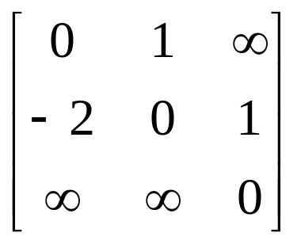
Graph with negative cycle
-2
0
1
2
1
1
(a) Directed graph (b) A⁻¹
The length of the shortest path from vertex 0 to vertex 2 is -∝.
0, 1, 0, 1,0, 1, …, 0, 1, 2

Slide 65
Algorithm for All Pairs Shortest Paths
void allcosts(int cost[][MAX_VERTICES],
int distance[][MAX_VERTICES], int n)
{
int i, j, k;
for (i=0; i<n; i++)
for (j=0; j<n; j++)
distance[i][j] = cost[i][j];
for (k=0; k<n; k++)
for (i=0; i<n; i++)
for (j=0; j<n; j++)
if (distance[i][k]+distance[k][j]
< distance[i][j])
distance[i][j]=
distance[i][k]+distance[k][j];
}

Slide 66
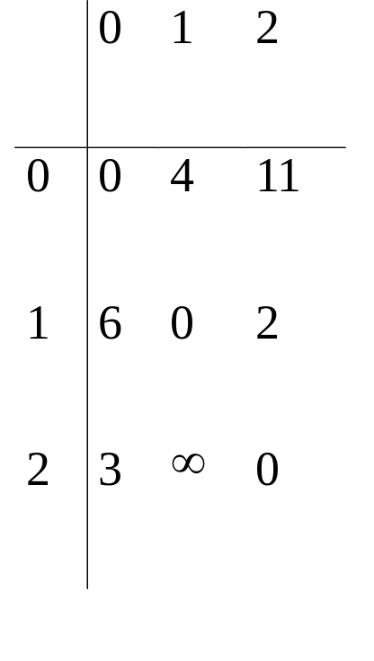
Directed graph and its cost matrix
6
4
V₀
V1
3 11 2
V₂
(a)Digraph G (b)Cost adjacency matrix for G

Slide 67
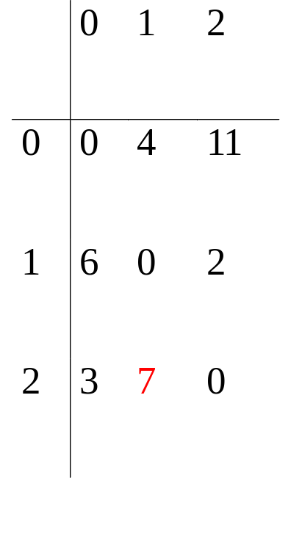
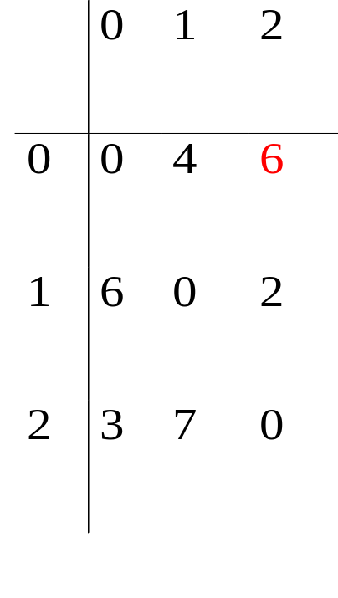
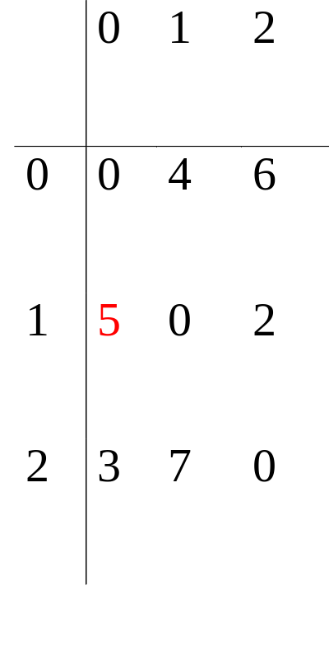
A⁻¹
6
4
A⁰
V₀
V1
A⁻¹
3 11 2
0 0
6 4
3 11
V₂
v0
A¹
A²
A⁰
A¹
6 3
2 7
0 0
4 6
0 0
7 2
v1
v2

Slide 68
Single Source Shortest Path: Dijkstra’s Algorithm
https://www.youtube.com/watch?v=YJfApSMbwaE

Slide 69

Single-Source Shortest Path Problem
Single-Source Shortest Path Problem - The problem of finding shortest paths from a source vertex v to all other vertices in the graph.

Slide 70
Dijkstra's algorithm
Dijkstra's algorithm - is a solution to the single-source shortest path problem in graph theory.
Works on both directed and undirected graphs. However, all edges must have nonnegative weights.
Approach: Greedy
Input: Weighted graph G={E,V} and source vertex v∈V, such that all edge weights are nonnegative
Output: Lengths of shortest paths (or the shortest paths themselves) from a given source vertex v∈V to all other vertices

Slide 71
Dijkstra's algorithm - Pseudocode
dist[s] ←0 (distance to source vertex is zero)
for all v ∈ V–{s}
do dist[v] ←∞ (set all other distances to infinity)
S←∅ (S, the set of visited vertices is initially empty)
Q←V (Q, the queue initially contains all vertices)
while Q ≠∅ (while the queue is not empty)
do u ← mindistance(Q,dist) (select the element of Q with the min. distance)
S←S∪{u} (add u to list of visited vertices)
for all v ∈ neighbors[u]
do if dist[v] > dist[u] + w(u, v) (if new shortest path found)
then d[v] ←d[u] + w(u, v) (set new value of shortest path)
(if desired, add traceback code)
return dist

Slide 72


Example

Slide 73
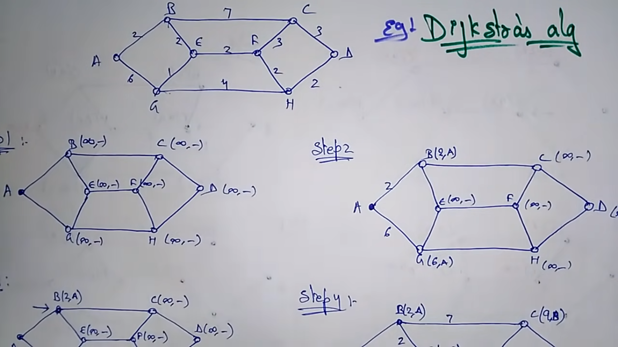
Example

Slide 74
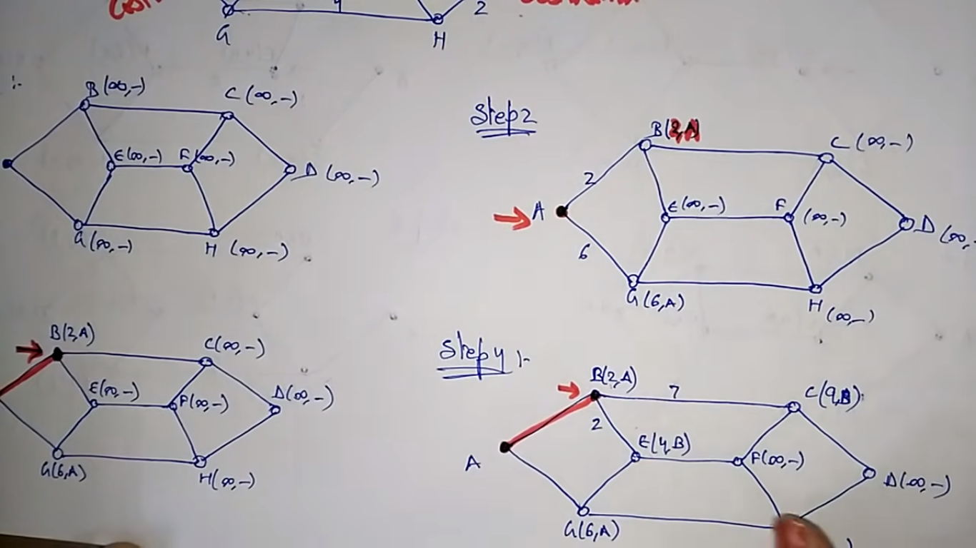
Example

Slide 75
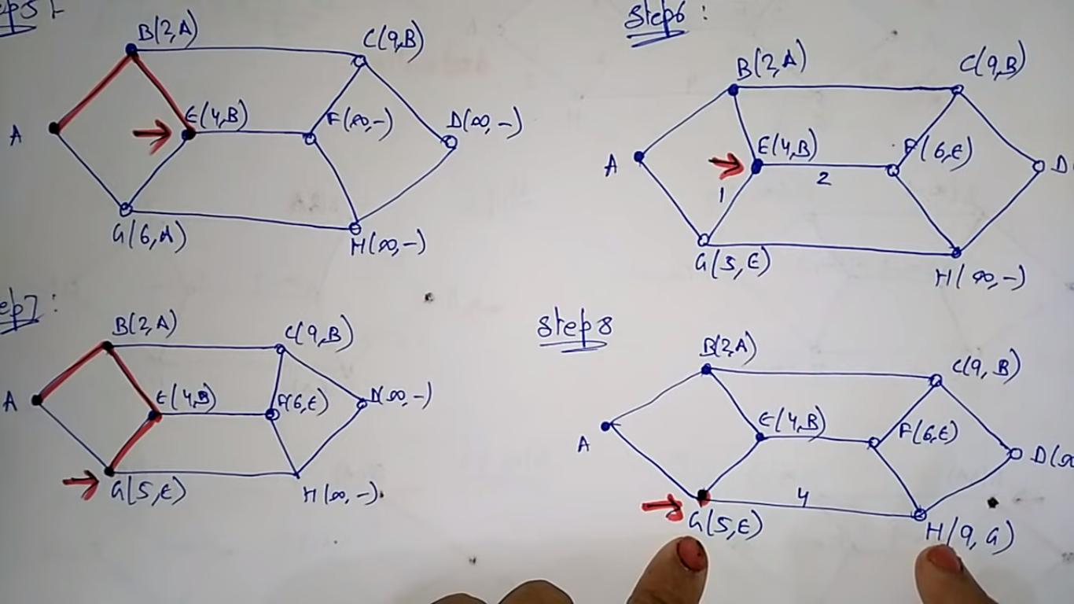
Example

Slide 76
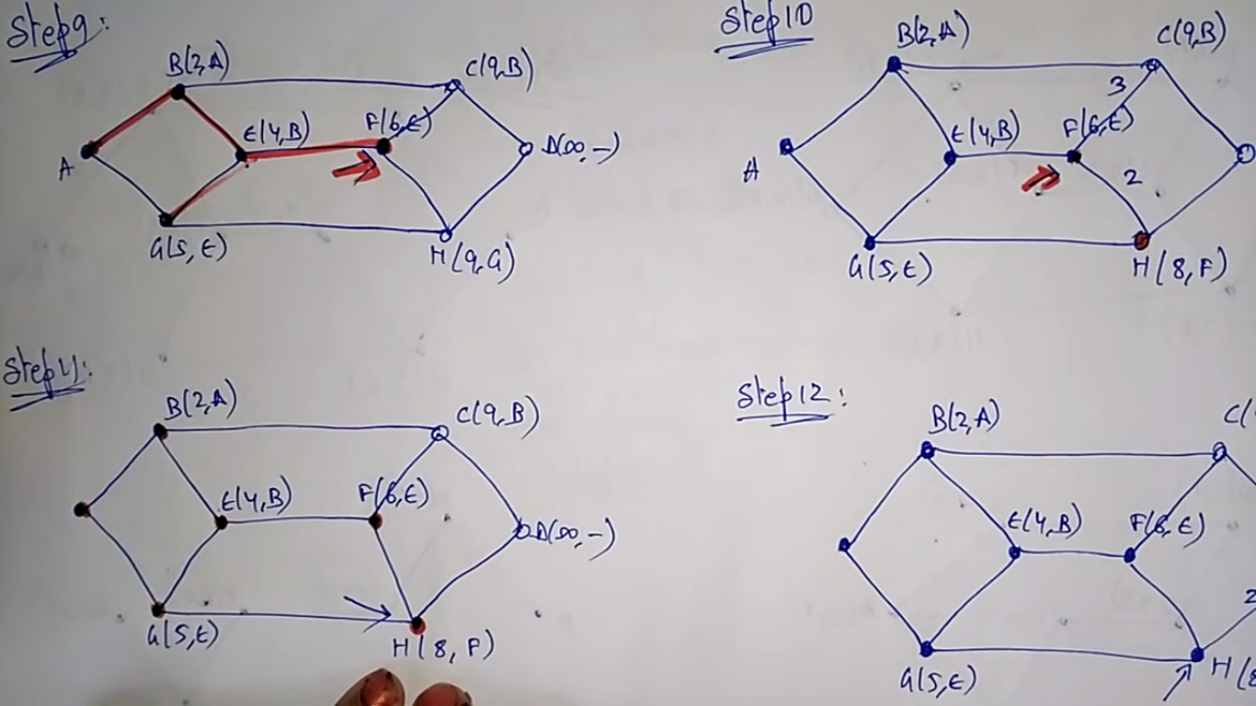
Example

Slide 77
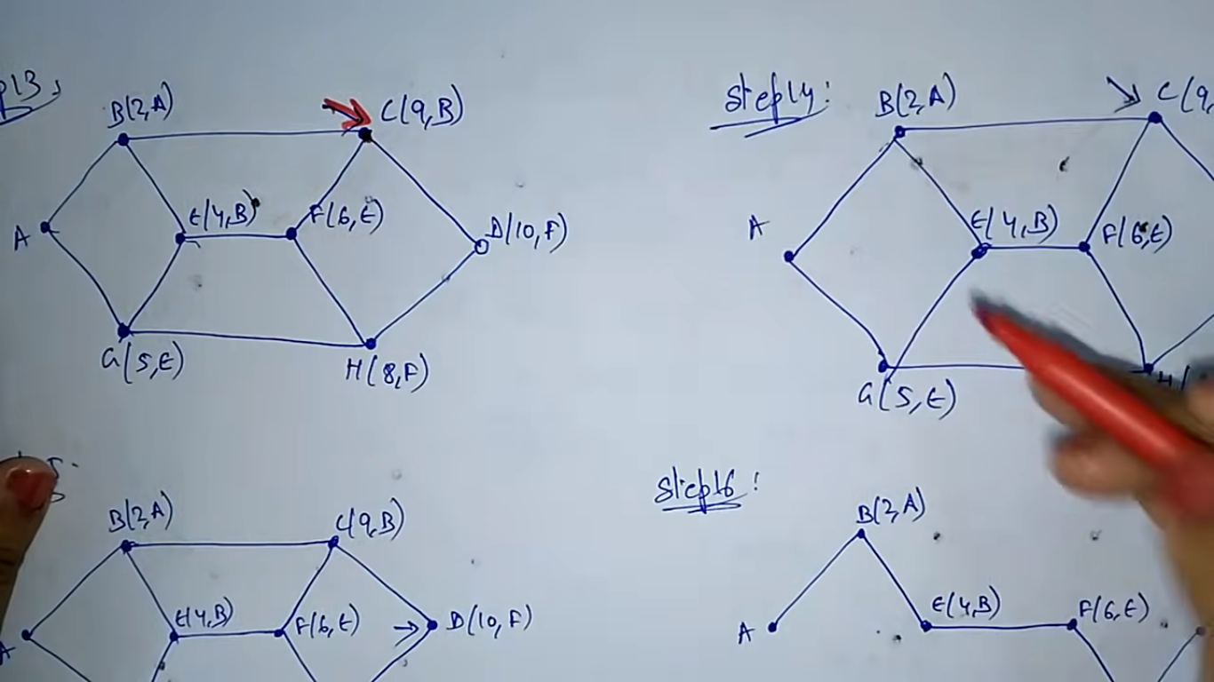
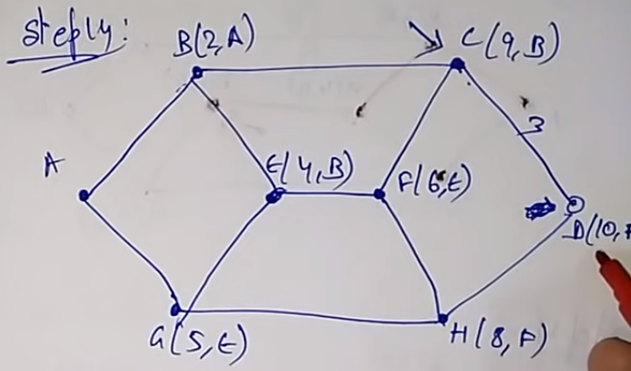
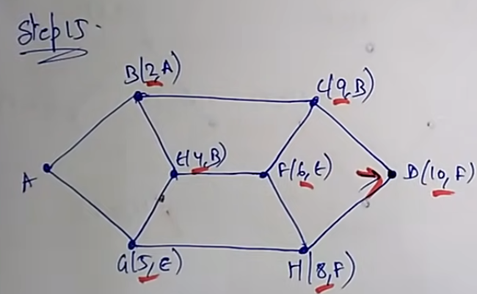
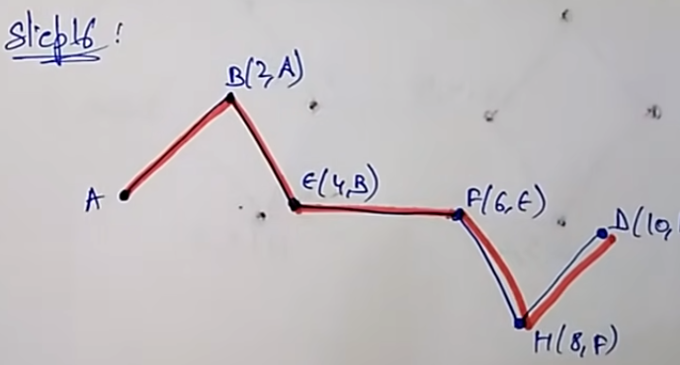
Example

Slide 78
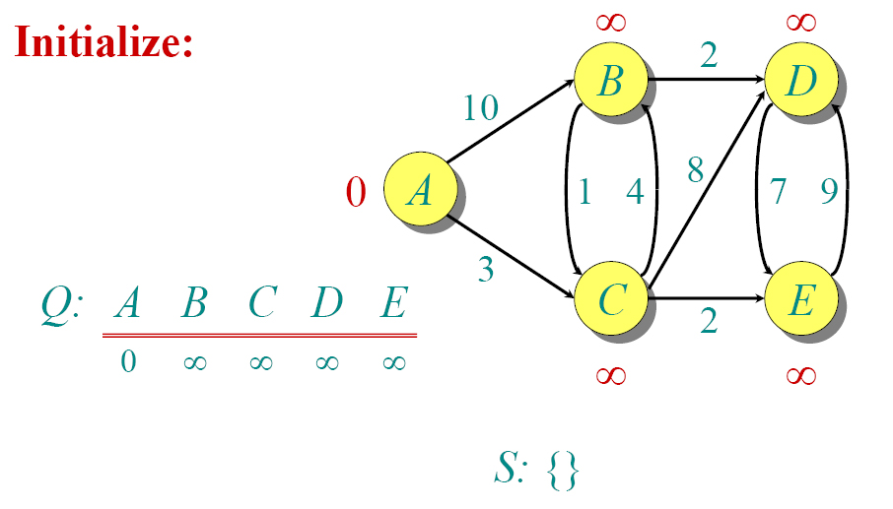
Dijkstra Animated Example

Slide 79

Dijkstra Animated Example

Slide 80

Dijkstra Animated Example

Slide 81

Dijkstra Animated Example

Slide 82

Dijkstra Animated Example

Slide 83

Dijkstra Animated Example

Slide 84

Dijkstra Animated Example

Slide 85

Dijkstra Animated Example

Slide 86

Dijkstra Animated Example

Slide 87

Dijkstra Animated Example

Slide 88
Implementations and Running Times
The simplest implementation is to store vertices in an array or linked list. This will produce a running time of
O(|V|^2 + |E|)
For sparse graphs, or graphs with very few edges and many nodes, it can be implemented more efficiently storing the graph in an adjacency list using a binary heap or priority queue. This will produce a running time of
O((|E|+|V|) log |V|)

Slide 89
Dijkstra's Algorithm - Why It Works
As with all greedy algorithms, we need to make sure that it is a correct algorithm (e.g., it always returns the right solution if it is given correct input).
A formal proof would take longer than this presentation, but we can understand how the argument works intuitively.
If you can’t sleep unless you see a proof, see the second reference or ask us where you can find it.

Slide 90
Dijkstra's Algorithm - Why It Works
To understand how it works, we’ll go over the previous example again. However, we need two mathematical results first:
Lemma 1: Triangle inequality
If δ(u,v) is the shortest path length between u and v,
δ(u,v) ≤ δ(u,x) + δ(x,v)
Lemma 2:
The subpath of any shortest path is itself a shortest path.
The key is to understand why we can claim that anytime we put a new vertex in S, we can say that we already know the shortest path to it.
Now, back to the example…

Slide 91
Dijkstra's Algorithm - Why use it?
As mentioned, Dijkstra’s algorithm calculates the shortest path to every vertex.
However, it is about as computationally expensive to calculate the shortest path from vertex u to every vertex using Dijkstra’s as it is to calculate the shortest path to some particular vertex v.
Therefore, anytime we want to know the optimal path to some other vertex from a determined origin, we can use Dijkstra’s algorithm.

Slide 92


Applications of Dijkstra's Algorithm
- Traffic Information Systems are most prominent use
- Mapping (Map Quest, Google Maps)
- Routing Systems

Slide 93
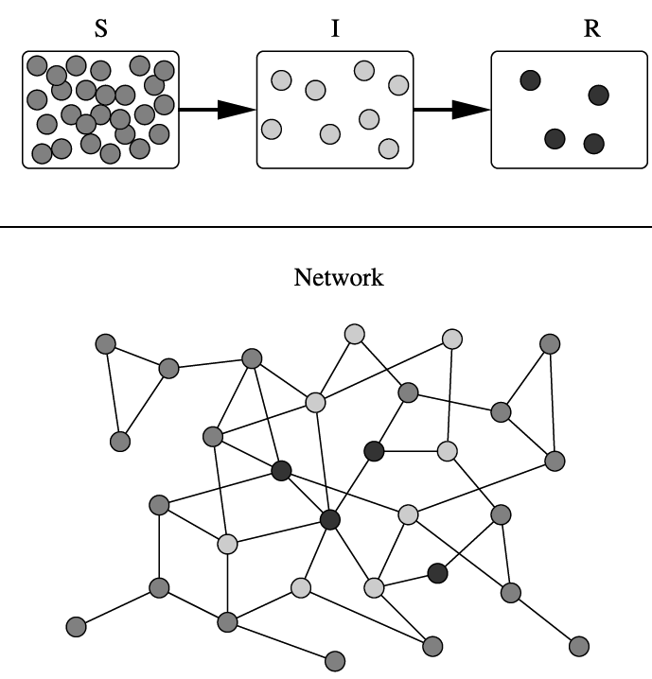
Applications of Dijkstra's Algorithm
One particularly relevant this week: epidemiology
Prof. Lauren Meyers (Biology Dept.) uses networks to model the spread of infectious diseases and design prevention and response strategies.
Vertices represent individuals, and edges their possible contacts. It is useful to calculate how a particular individual is connected to others.
Knowing the shortest path lengths to other individuals can be a relevant indicator of the potential of a particular individual to infect others.

Slide 94
References
Dijkstra’s original paper:
E. W. Dijkstra. (1959) A Note on Two Problems in Connection with Graphs. Numerische Mathematik, 1. 269-271.
MIT OpenCourseware, 6.046J Introduction to Algorithms.
< http://ocw.mit.edu/OcwWeb/Electrical-Engineering-and-Computer-Science/6-046JFall-2005/CourseHome/> Accessed 4/25/09
Meyers, L.A. (2007) Contact network epidemiology: Bond percolation applied to infectious disease prediction and control. Bulletin of the American Mathematical Society 44: 63-86.
Department of Mathematics, University of Melbourne. Dijkstra’s Algorithm.
<http://www.ms.unimelb.edu.au/~moshe/620-261/dijkstra/dijkstra.html > Accessed 4/25/09

Slide 95
END

